Slide 1

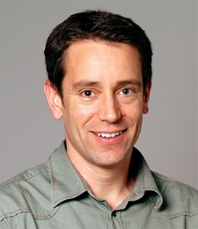
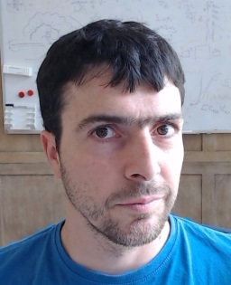
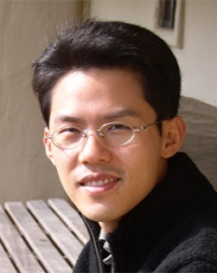
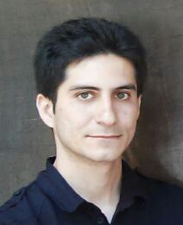
Denoising Your Monte Carlo Renders:
Recent Advances in Image-Space Adaptive Sampling and Reconstruction
Pradeep Sen
UC Santa Barbara
Matthias Zwicker
University of Bern
Fabrice Rousselle
Disney Research
Sung-Eui Yoon
KAIST
Nima Khademi Kalantari
UC Santa Barbara

Slide 2
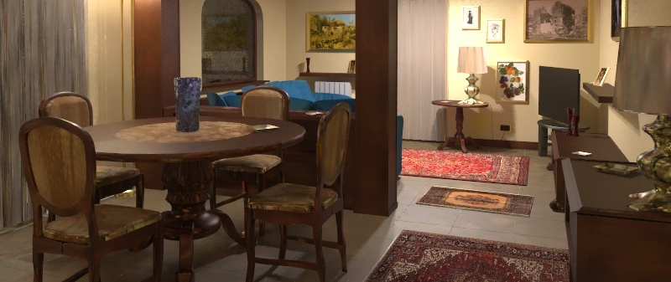

FILTERING NOISE FROM RANDOM PARAMETERS IN MC RENDERING
scene by Luca Cugia

Slide 3
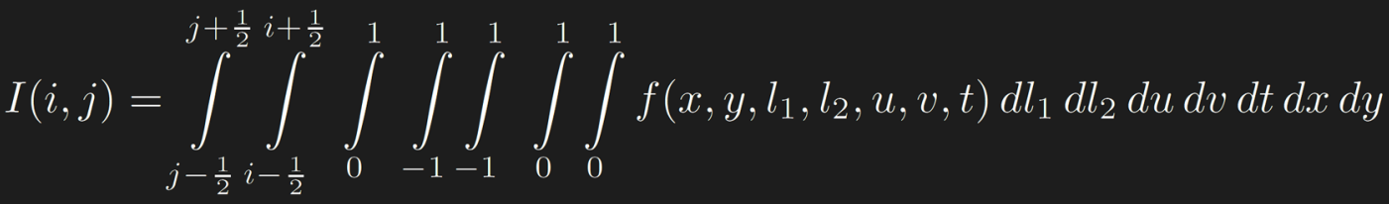
Our key observation
MC noise occurs when sample values are functions of random parameters of MC system
Desirable scene detail is not a function of these random parameters
random parameters

Slide 4
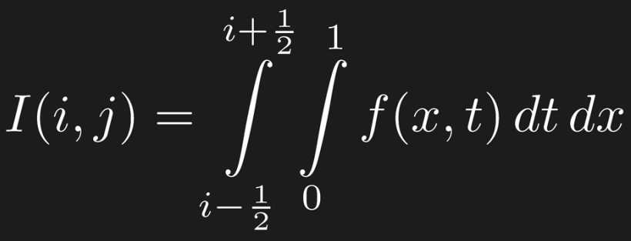



Simple illustration
t
1
0
x
i – 1/2
i + 1/2
i – 1/2
i + 1/2
Where varies with respect to , the random values for will produce noise at the output
Where is constant with respect to , high frequency content at the output is scene detail

Slide 5
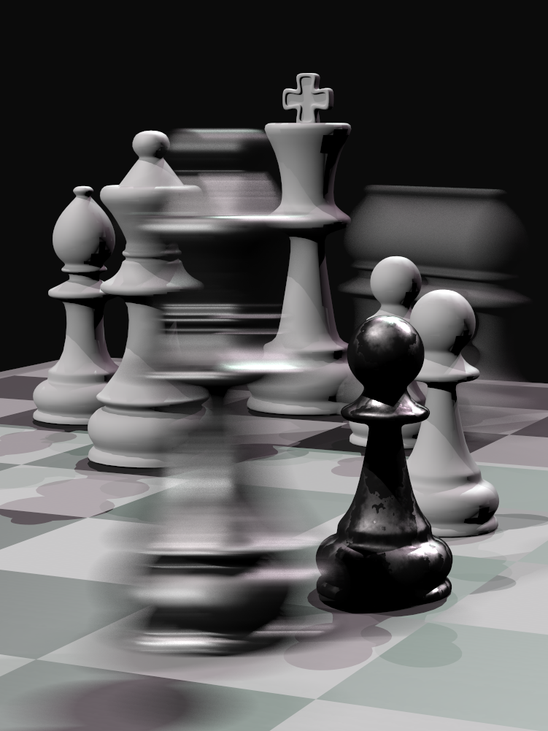
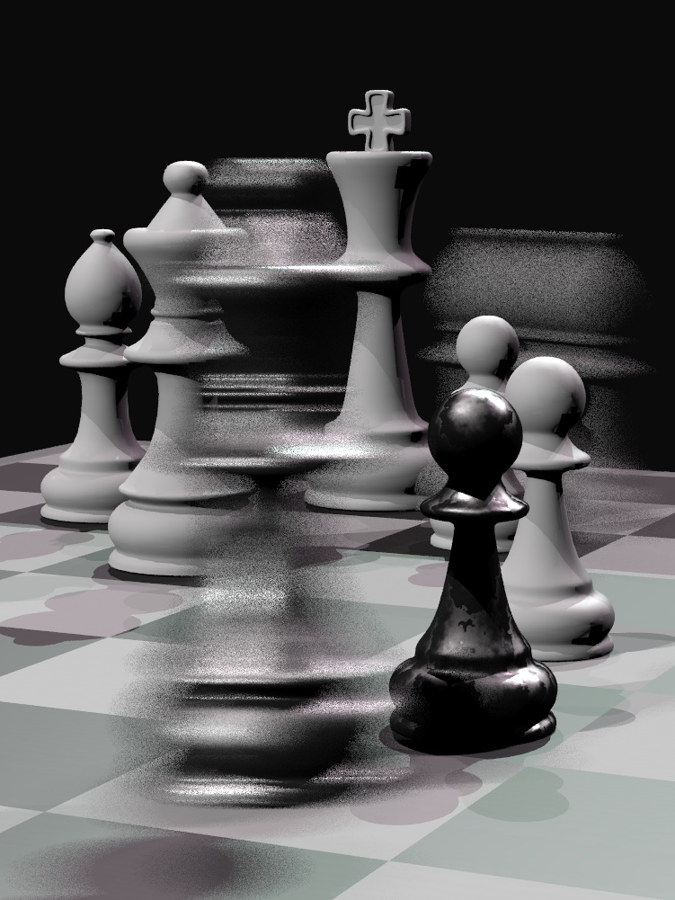
Example
scene by Wojciech Jarosz
1,024 samples/pixel
16 samples/pixel

Slide 6
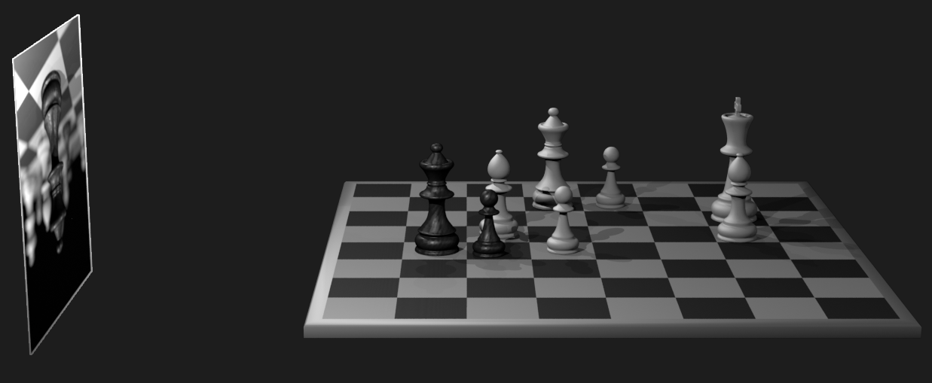
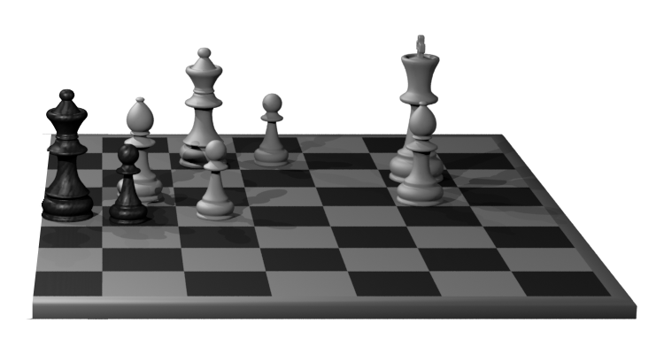

Depth of Field (DoF)
The same is true for depth of field effects
focal plane
image plane
scene
lens
Color of the ray is not dependent on value of on the lens
Color differences between pixels are scene features, not MC noise

Slide 7
Depth of Field (DoF)
The same is true for depth of field effects
focal plane
image plane
scene
lens
Color of the ray depends on the value of on the lens
Color differences between pixels are Monte Carlo noise not scene detail

Slide 8
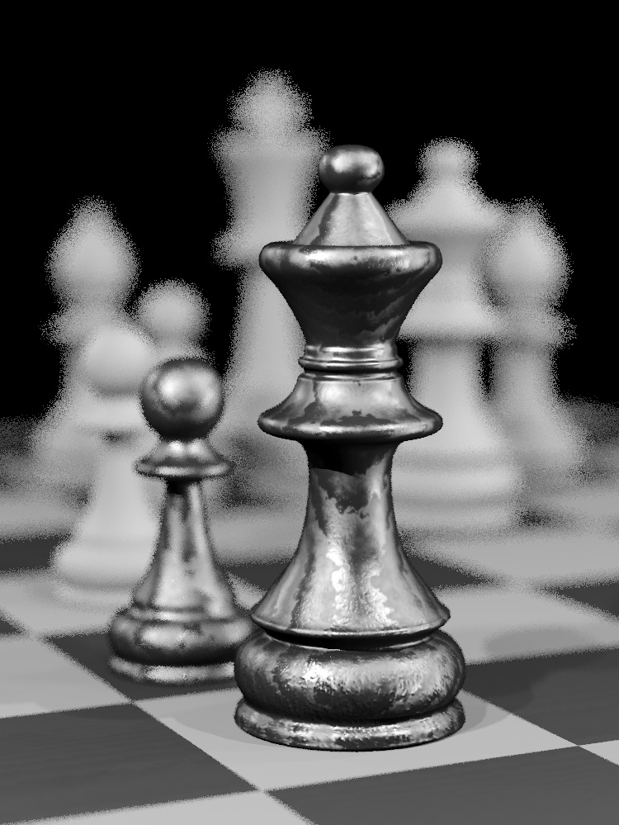
Depth of Field (DoF)
scene by Wojciech Jarosz
8 samples/pixel

Slide 9
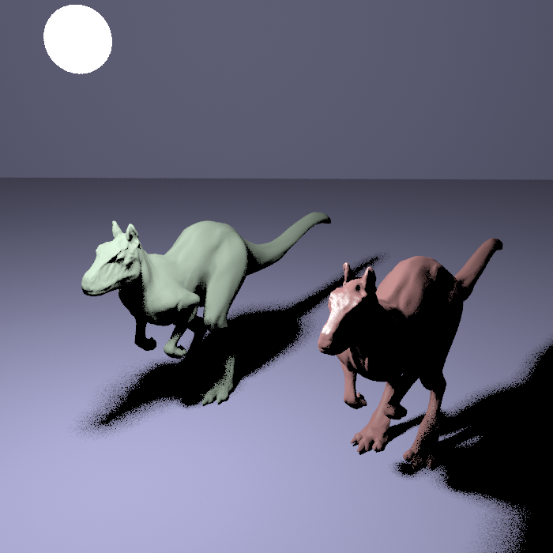
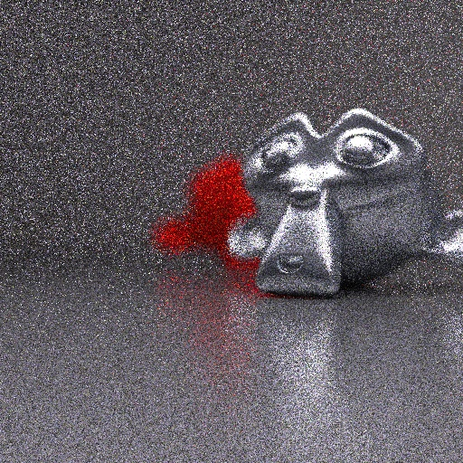
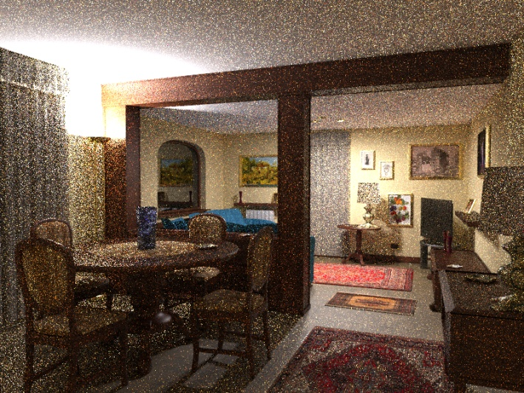
This works for other effects
Area light sources
Glossy reflections
Path-tracing
Blender distribution scene
models by headus/Rezard
scene by Luca Cugia

Slide 10
Our key observations
MC noise occurs only where sample values are functions of MC random parameters
The challenge: how do we identify where this is happening in a general scene from just a few samples?

Slide 11
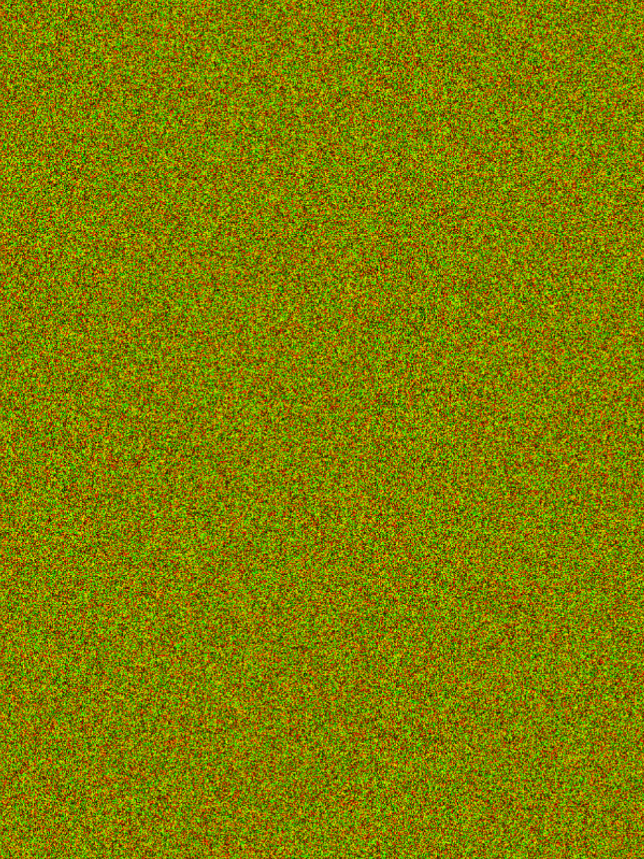



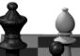
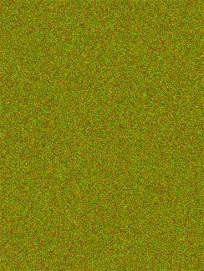
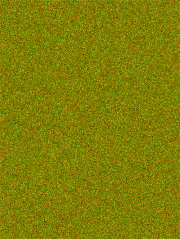
Our formulation
To do this we treat the rendering system as a black box
(x,y)
scene function black box
f(x,y,u,v)
(u,v)
(x,y)
implemented by the rendering system
(u,v)
sample colors
functional dependency?
We need a way to estimate this functional dependency

Slide 12
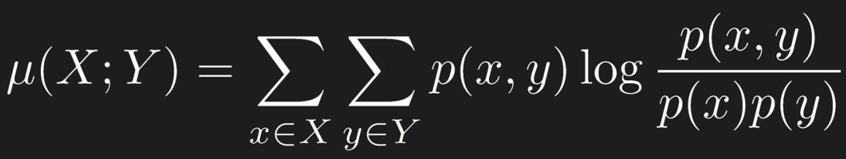
Estimating functional dependency
We use mutual information from information theory:
Measure of statistical dependence between two random variables

Slide 13
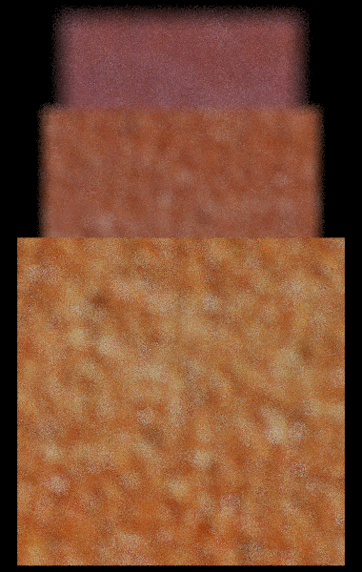
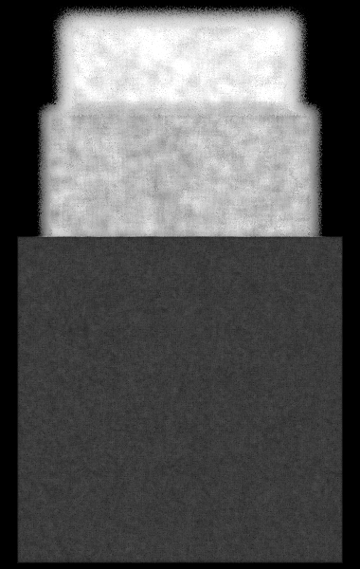
Using mutual information
Detects the dependence of the color on the lens position for our simple example
bright: high statistical dependence
dark: low statistical dependence
dependency of color on lens position (u,v)
8 samples/pixel

Slide 14
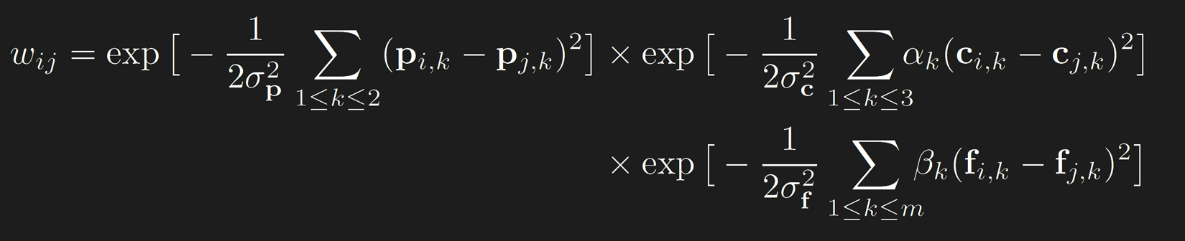


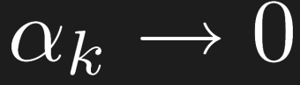
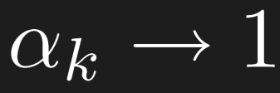
Our Random Parameter Filter (RPF)
Modify bilateral filter using mutual information to control impact of color channels
If color is very dependent on random params, it is noise: set (ignore color differences to filter noise)
If color is not dependent on random params, set (preserve scene detail)

Slide 15
Results

Slide 16
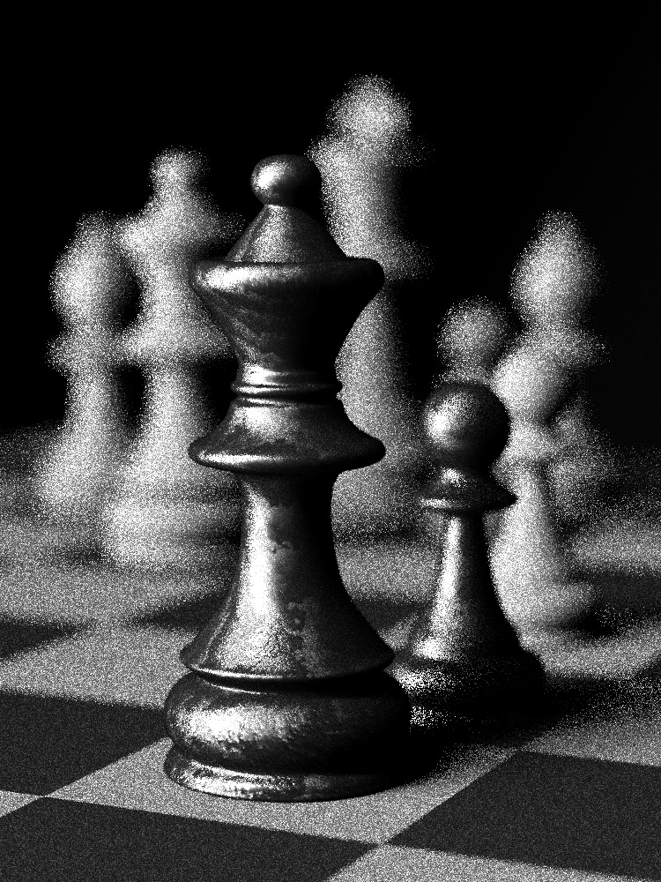
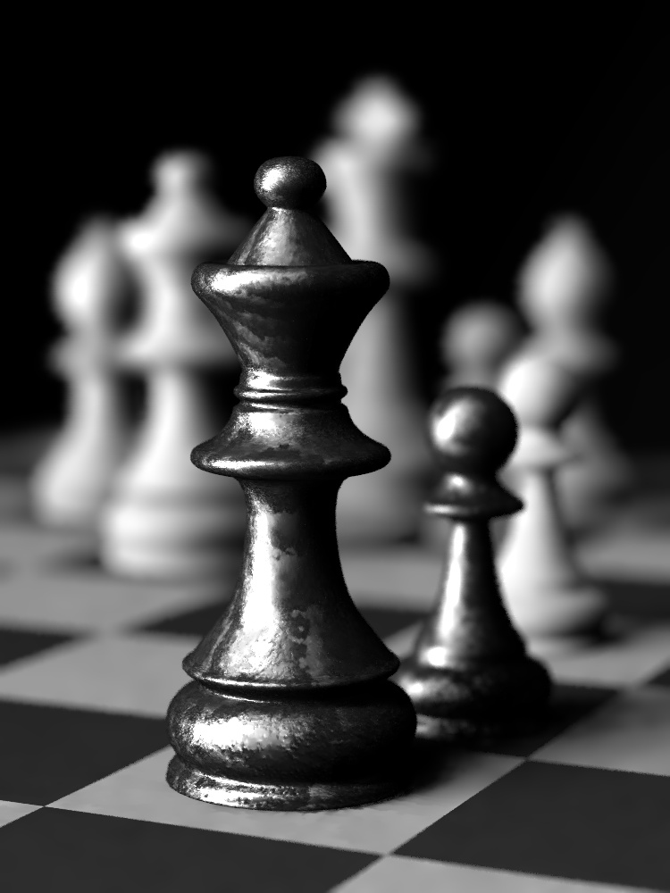
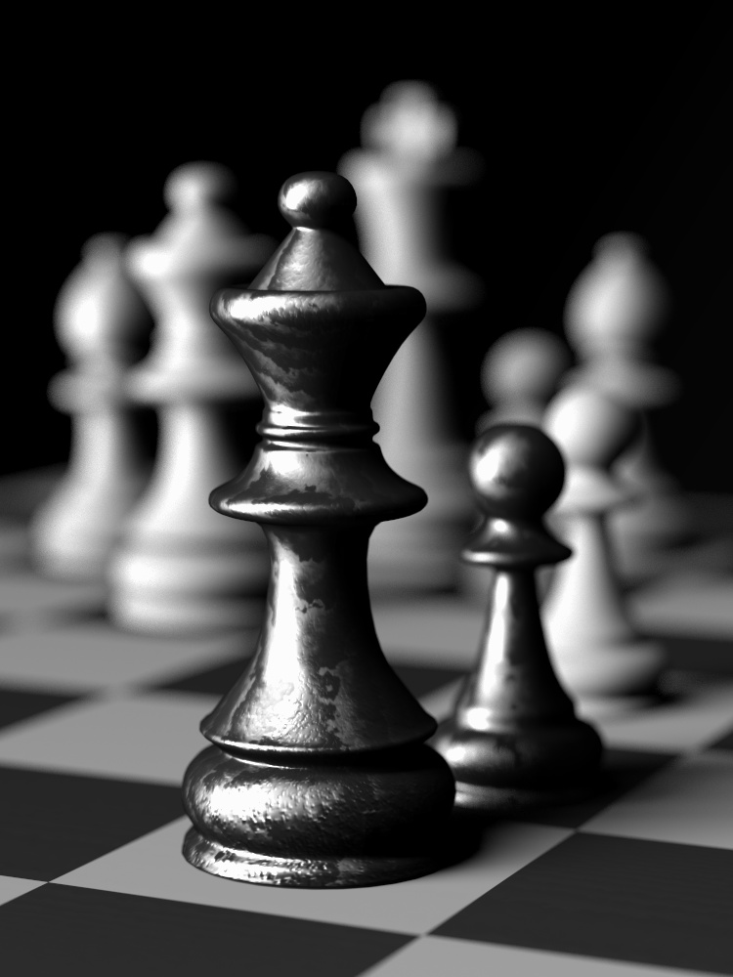
Chess scene (DoF + area light)
scene by Wojciech Jarosz
our result (8 samples/pixel)
4.9 mins
reference (8,192 samples/pixel)
1.2 hrs
input rendering (8 samples/pixel)
7.13 secs

Slide 17
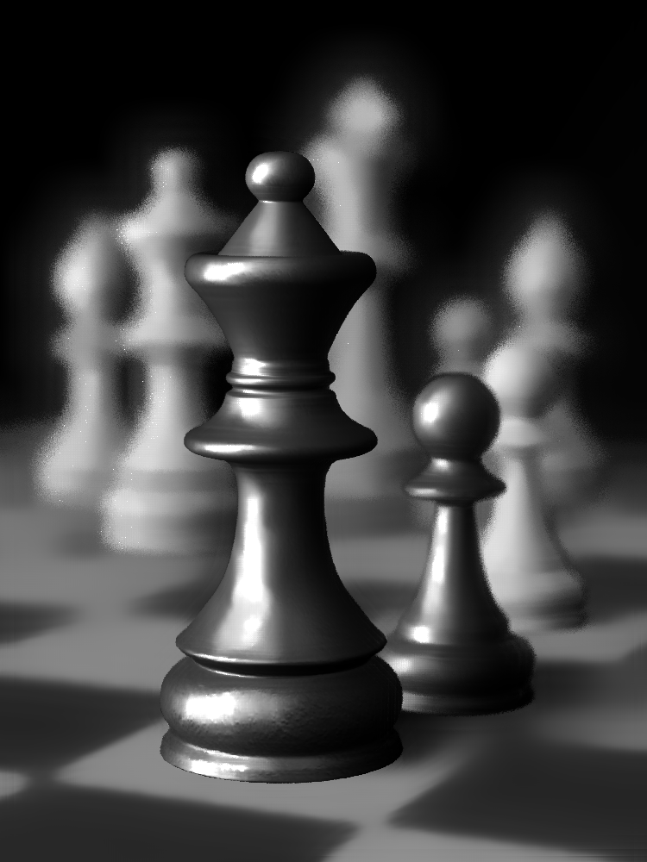
Chess scene (DoF + area light)
scene by Wojciech Jarosz
our result (8 samples/pixel)
reference (8,192 samples/pixel)
À-Trous filter (8 samples/pixel)
Dammertz et al. [2010]

Slide 18



Toy Gyro scene
scene by Jesper Lloyd
input (8 samples/pixel) 76 secs
our result (8 samples/pixel) 15.9 mins
reference (8,192 samples/pixel) 20 hrs

Slide 19
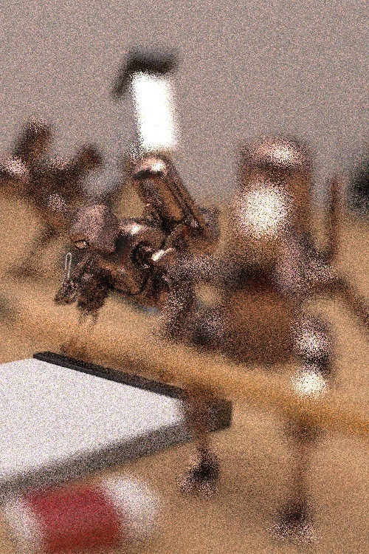
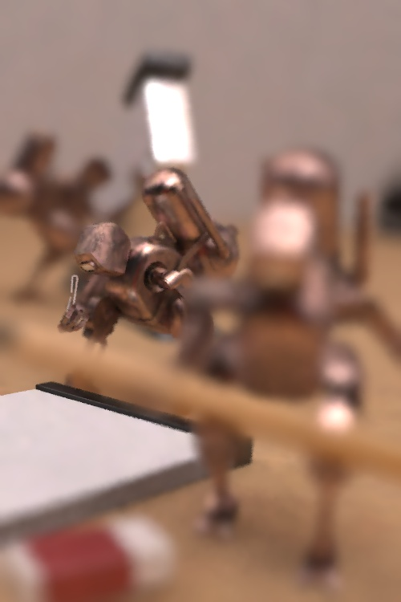
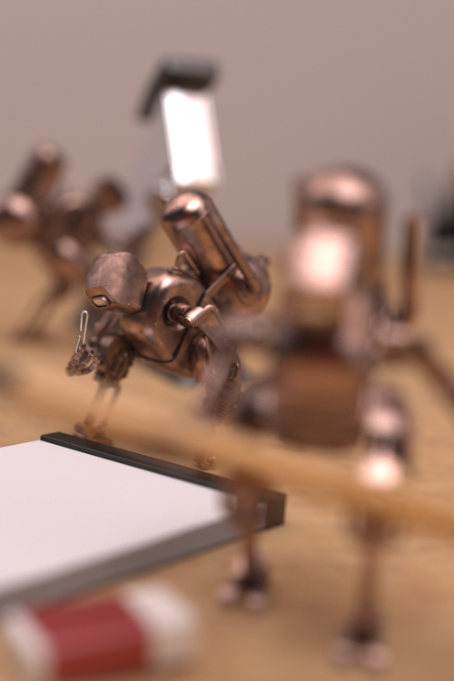
Robots scene
scene by Jesper Lloyd
input (8 samples/pixel)
15 secs
our result (8 samples/pixel)
1.7 mins
reference (8,192 samples/pixel)
4 hours

Slide 20
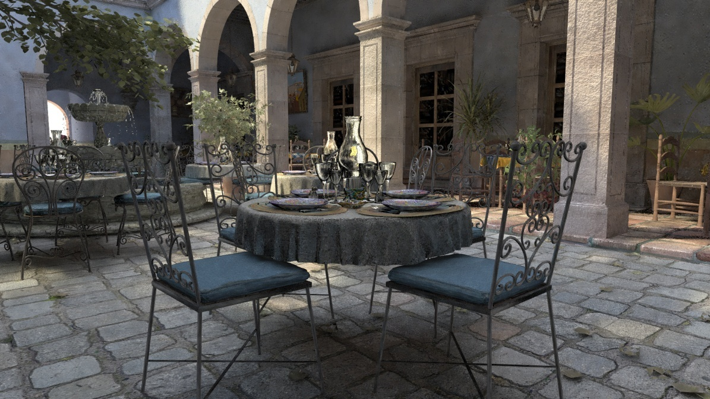
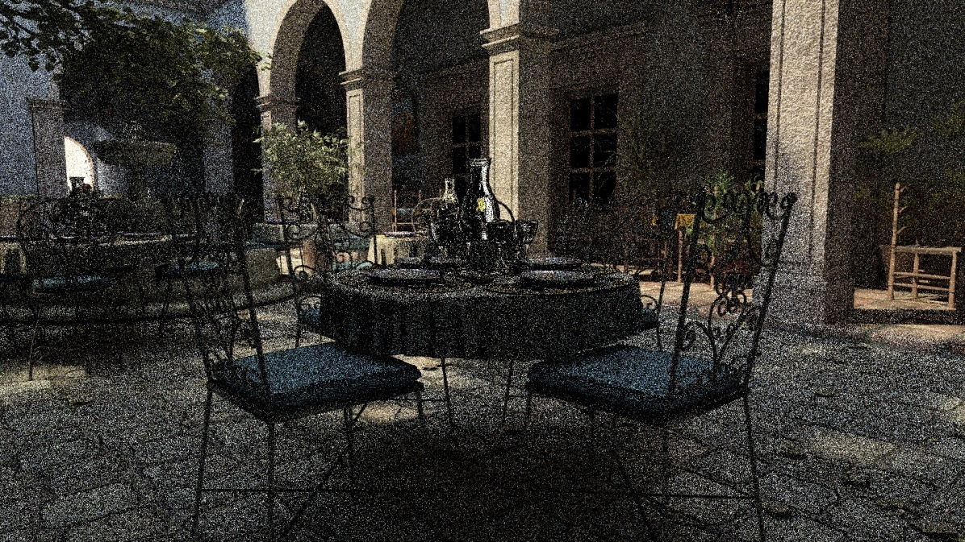
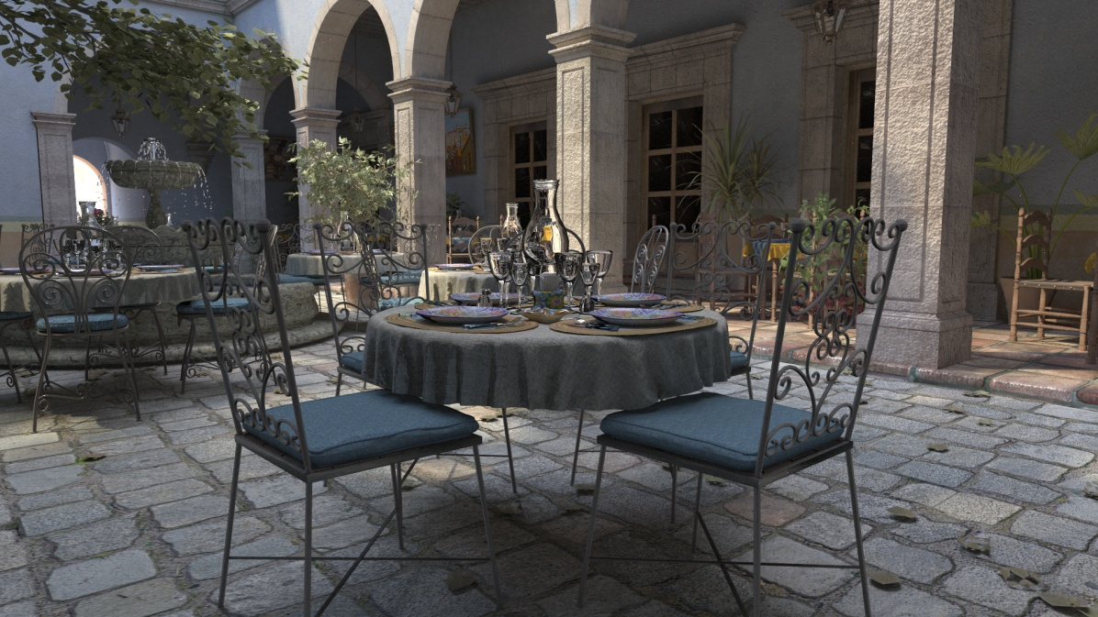
San Miguel scene
scene by M. Leal Llaguno
input (8 samples/pixel) 1.8 mins
speed up of 100x
our result (8 samples/pixel) 14.8 mins
reference (8,192 samples/pixel) 24.3 hrs

Slide 21

San Miguel scene video (1920 x 1080)
scene by M. Leal Llaguno
input (8 samples/pixel)
1.8 mins/frame

Slide 22
San Miguel scene video (1920 x 1080)
scene by M. Leal Llaguno
[
]
our result (8 samples/pixel)
14.8 mins/frame
reference
24.3 hrs/frame

Slide 23
Reflections, 5 years later
RPF provides reasonable filter quality at separating noise from scene detail
Sample based (not per-pixel), so is expensive at higher sampling rates (slower than later methods)
This problem addressed in:
Park et al. 2013 “P-RPF: Pixel-based Random Parameter Filtering for Monte Carlo Rendering”
Also, RPF does not minimize the error w.r.t. ground truth directly

Slide 24
The papers
P. Sen and S. Darabi, “On Filtering the Noise from the Random Parameters in Monte Carlo Rendering,” ACM Transactions on Graphics, Vol. 31, No. 3, May 2012 (presented at SIGGRAPH 2012)
P. Sen and S. Darabi, “Implementation of Random Parameter Filtering,” University of New Mexico Tech. Report ECE-TR-11-0004, Sep. 2011

Slide 25

Source code available!
RPF code available here:
http://dx.doi.org/10.7919/F4MW2F28

Slide 26
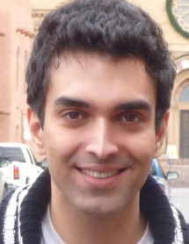

Acknowledgments
Student:
  Soheil Darabi
Funding:
  National Science Foundation IIS 08-45396

